Slide 1
Salary Prediction of Data Professions
Machine Learning Internship Project

Slide 2
Dataset Overview
Introduction
Objective: Predict salaries of data professionals using machine learning techniques.
Importance: Helps job seekers understand market trends and assists employers in salary benchmarking.
This includes features like SEX, DOJ, CURRENT DATE, DESIGNATION, AGE, UNIT, LEAVES USED, LEAVES REMAINING, RATINGS, and PAST EXP.
Target variable: salary

Slide 3
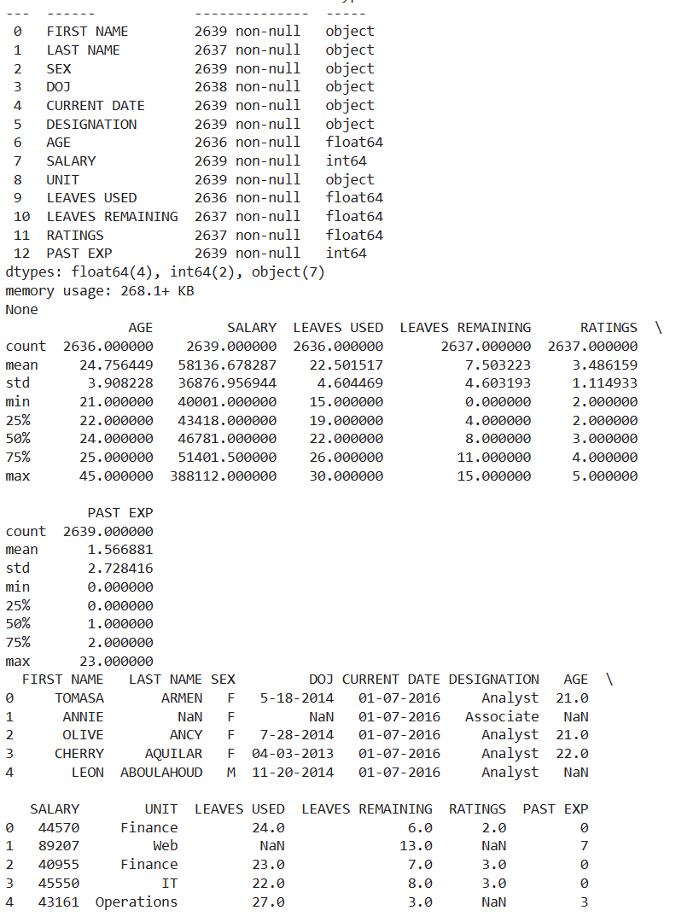
Output
Exploratory Data Analysis (EDA)
Data Inspection: Load the dataset and inspect its structure (columns, data types, missing values, etc.).
Use Python libraries like pandas for loading and inspecting the dataset.
Use info(), describe(), and head() methods for a preliminary look.
Generate summary statistics for numerical and categorical variables.
Use describe() for numerical data.
Use value_counts() for categorical data.
Data Visualization: Visualize distributions, correlations, and relationships between variables.
Use libraries like matplotlib, seaborn, and plotly for creating plots (histograms, box plots, scatter plots, correlation heatmaps).

Slide 4
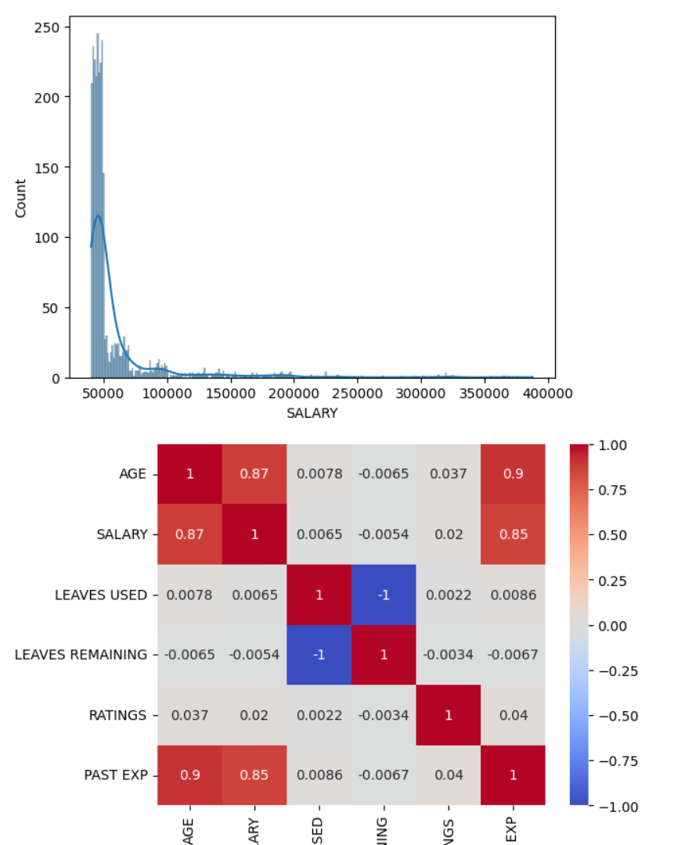
Output

Slide 5
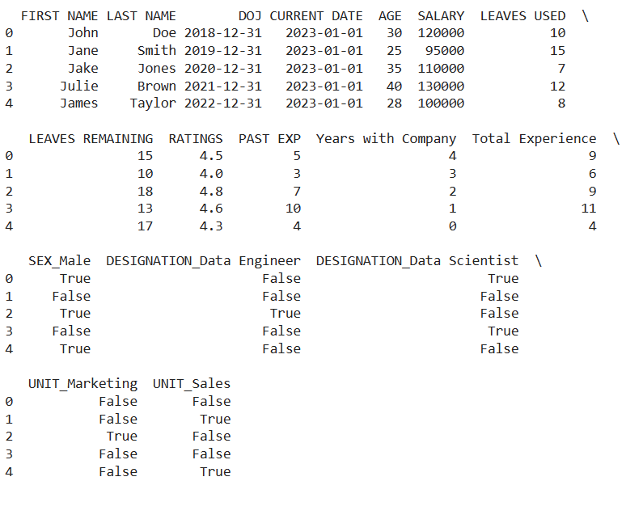
Data Preprocessing
Output
Handle Missing Values: Decide on a strategy to handle missing values (e.g., imputation, removal).
Use SimpleImputer from sklearn or manual imputation techniques.
Encode Categorical Variables: Convert categorical variables into numerical format.
Use OneHotEncoder or LabelEncoder from sklearn.
Scaling/Normalization: Scale or normalize the numerical features.
Use StandardScaler or MinMaxScaler from sklearn.

Slide 6
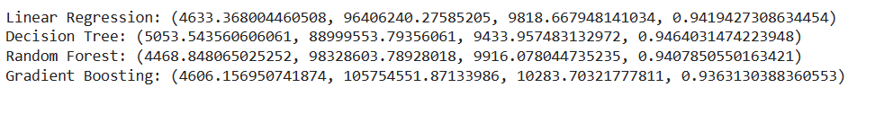
Model Development
Split Data: Split the dataset into training and testing sets.
Use train_test_split from sklearn.
Train Models: Train different regression models and compare their performance.
Start with simple models like Linear Regression.
Experiment with more complex models like Decision Trees, Random Forests, Gradient Boosting.
Use Linear Regression, Decision Tree Regression, Random Forest Regression, Gradient Boosting Regression from sklearn.
Output

Slide 7
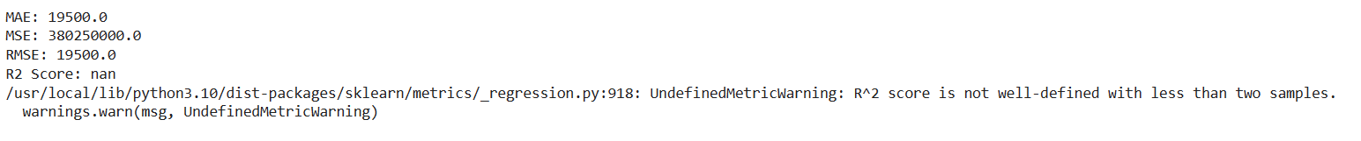
Model Evaluation
Objective: Assess the performance of your models using appropriate metrics.
Tasks:
Evaluate Models: Calculate evaluation metrics like MAE, MSE, RMSE, and R-squared for each model.
Use mean_absolute_error, mean_squared_error, r²_score from sklearn.metrics.
Compare Models: Compare the performance of different models and select the best-performing one.
Output

Slide 8
Tools and Technologies
Python : Programming language.
Libraries : pandas, numpy, matplotlib, seaborn, sklearn, flask or fastapi.
Development Environment : Jupyter Notebook, any Python IDE or Google colab.
Google colab : https://colab.research.google.com/
For more details :
https://colab.research.google.com/drive/18Mpd2Hc3Ny_d9u6MwVa6Cbz1lEfplwop
Dataset

